Slide 1
ER-modeling

Slide 2
ER-modeling
ER-modeling is a data modeling method used in software engineering to produce a conceptual data model of an information system. Diagrams created using this ER-modeling method are called Entity-Relationship Diagrams or ER diagrams or ERDs.
The database analyst gains a better understanding of the data to be contained in the database through the step of constructing the ERD.
The ERD serves as a documentation tool.
Finally, the ERD is used to connect the logical structure of the database to users. In particular, the ERD effectively communicates the logic of the database to users.

Slide 3
COMPONENTS OF ERD

Slide 4
Components of an ER Diagrams
Entity
An entity can be a real-world object, either animate or inanimate, that can be merely identifiable. An entity is denoted as a rectangle in an ER diagram. For example, in a school database, students, teachers, classes, and courses offered can be treated as entities. All these entities have some attributes or properties that give them their identity.

Slide 5
Components of an ER Diagrams
Attributes
Entities are denoted utilizing their properties, known as attributes. All attributes have values. For example, a student entity may have name, class, and age as attributes.
There exists a domain or range of values that can be assigned to attributes. For example, a student's name cannot be a numeric value. It has to be alphabetic. A student's age cannot be negative, etc.

Slide 6
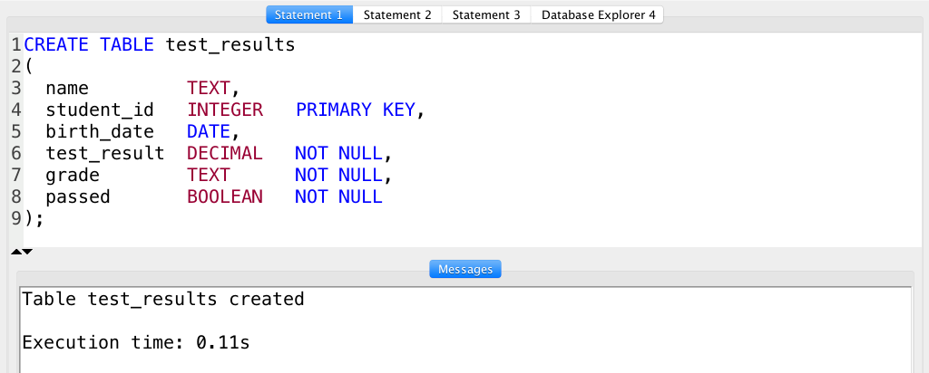

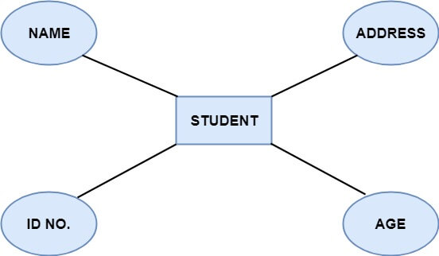
.

Slide 7
Attributes
There are four types of Attributes:
Key attribute
Composite attribute
Single-valued attribute
Multi-valued attribute
Derived attribute

Slide 8
Key attribute
Uniquely identifies an entity among the entity set.
There are mainly three types of keys:
Super key: A set of attributes that collectively identifies an entity in the entity set.
Candidate key: A minimal super key is known as a candidate key. An entity set may have more than one candidate key.
Primary key: A primary key is one of the candidate keys chosen by the database designer to uniquely identify the entity set.

Slide 9
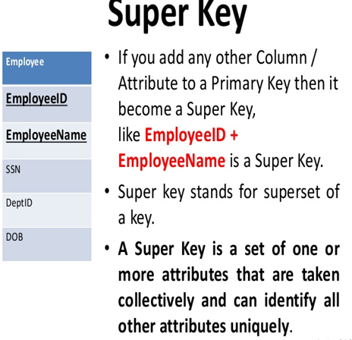
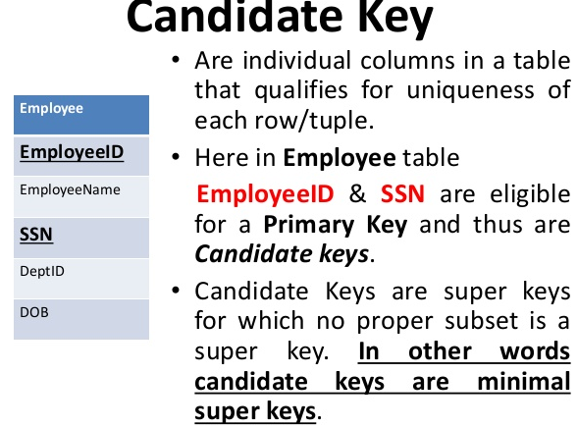
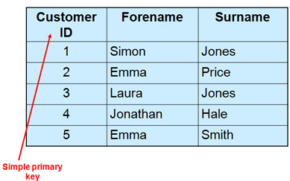

Slide 10
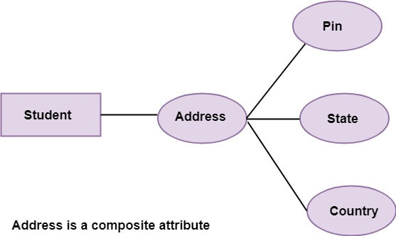
Composite attribute
An attribute that is a combination of other attributes is called a composite attribute.
.

Slide 11
Single-valued attribute: Single-valued attribute contain a single value. For example, Social_Security_Number.
Multi-valued Attribute: If an attribute can have more than one value, it is known as a multi-valued attribute. Multi-valued attributes are depicted by the double ellipse. For example, a person can have more than one phone number, email-address, etc.

Slide 12
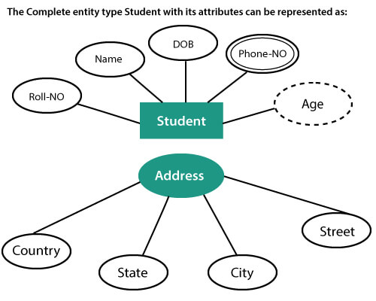
Derived attribute: Derived attributes are the attribute that does not exist in the physical database, but their values are derived from other attributes present in the database. For example, age can be derived from date_of_birth.

Slide 13
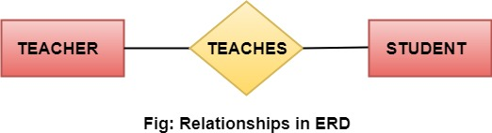
Relationships
The association among entities is known as relationship. Relationships are represented by the diamond-shaped box. For example, an employee works_at a department, a student enrolls in a course. Here, Works_at and Enrolls are called relationships.

Slide 14
Relationship set
A set of relationships of a similar type is known as a relationship set. Like entities, a relationship too can have attributes. These attributes are called descriptive attributes.
Degree of a relationship set
The number of participating entities in a relationship describes the degree of the relationship. The three most common relationships in E-R models are:
Unary (degree1)
Binary (degree2)
Ternary (degree3)

Slide 15
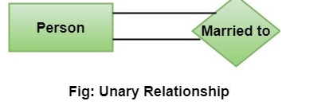
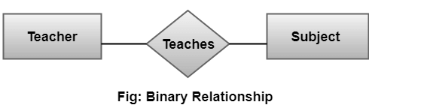
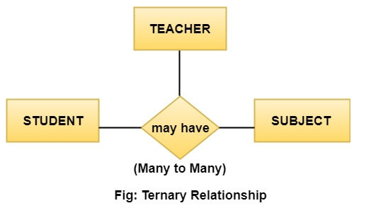

Slide 16
Cardinality
Cardinality describes the number of entities in one entity set, which can be associated with the number of entities of other sets via relationship SET.
TYPES
ONE TO ONE
MANY TO ONE
MANY TO MANY
ONE TO MANY

Slide 17
Entity-Relationship Diagrams
Binary Relationship
EMPLOYEE
Is assigned
PARKING PLACE
One to One
PRODUCT LINE
Contains
PRODUCT
One to many
STUDENT
Registers for
COURSE
Many to many

Slide 18
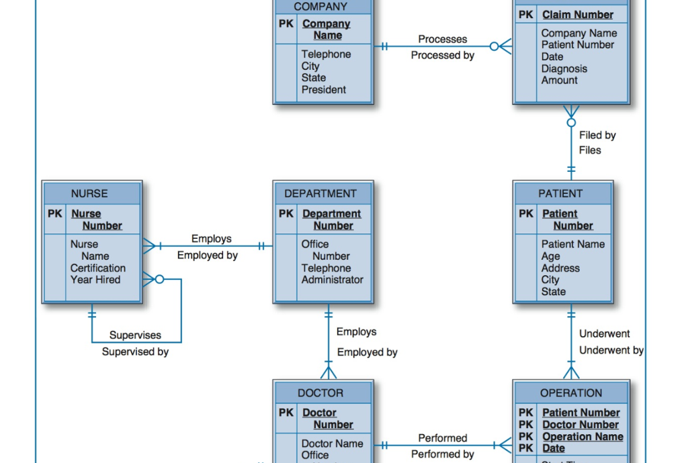

Slide 19
